Slide 1




HOW IS INDIA EVOLVING?
CIRMES?
WOMEN EMPOWERMENT?
DEVELOPMENT?
DATA SCIENCE LAB 1
INSTRUCTOR-DOOTIKA VATS

Slide 2





OUR VISION
-We are a data analytics startup dedicated to providing insights into the socio-economic status and demographic trends of women across various states in India
-Provides state-level comparisons to highlight critical areas needing focus.
TARGET AUDIENCE
Target audience includes government bodies, policymakers, and the public.
Supports data-driven decision-making to enhance women’s welfare and security.

Slide 3





DATA COLLECTION
RANKING OF ALL STATES
WOMEN AND ELECTIONS
CRIME AGAINST WOMEN
HOW WOMEN AFFECT SOCITY?

Slide 4



1
TOP STATES IN DIFFERENT DEVELOPEMENT ASPECTS
Here we our comparing states of India to get a better understanding of its development and other factors.
3
WOMEN IN ELECTIONS
Focuses on understanding the participation, impact of women in electoral processes and effect of crime cases
2
CRIME AGAINST WOMEN
Divided into three parts
Incidence of crime against women
Different crime analysis
Are We improving over time?
3 TABS

Slide 5
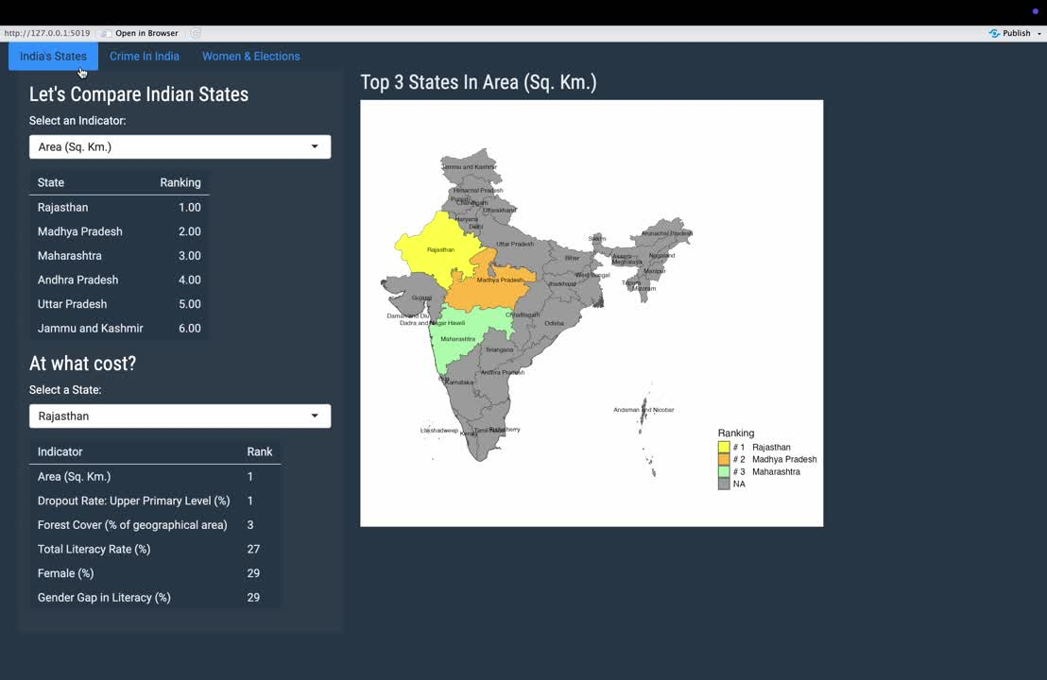
LETS SEE!!

Slide 6



THANK YOU
GROUP-3
Manas Jain Kuniya
Shreya Saha
Anshika Rai
Khushi

